Slide 1
Git’n Pro with HTML/CSS
Day 2
October 25, 2017

Slide 2
Where to Get Help
Practice, Practice, Practice: Work Individually or in Groups
Review In Class Material (Exercises and Slides): https://github.com/RutgersCodingBootcamp/10-23-2017-NB-Class-Repository-FSF/tree/master/Week-1/1.1
Re-Watch Class Videos: https://codingbootcamp.hosted.panopto.com/Panopto/Pages/Viewer.aspx?id=acd9b356-08b4-4eef-a822-3e435c5970df
In Class Office Hours: 45 minutes before class, 30 minutes after
One-on-One Sessions: By Announcement through SSM
Contact Student Success: Anytime!

Slide 3
Today’s Class!

Slide 4
Today’s Objectives
Introduction to Version Control
Get up and running with Github
Introduction to HTML
Introduction CSS
Implement HTML & CSS to make a basic webpage

Slide 5
What / Why Git?

Slide 6
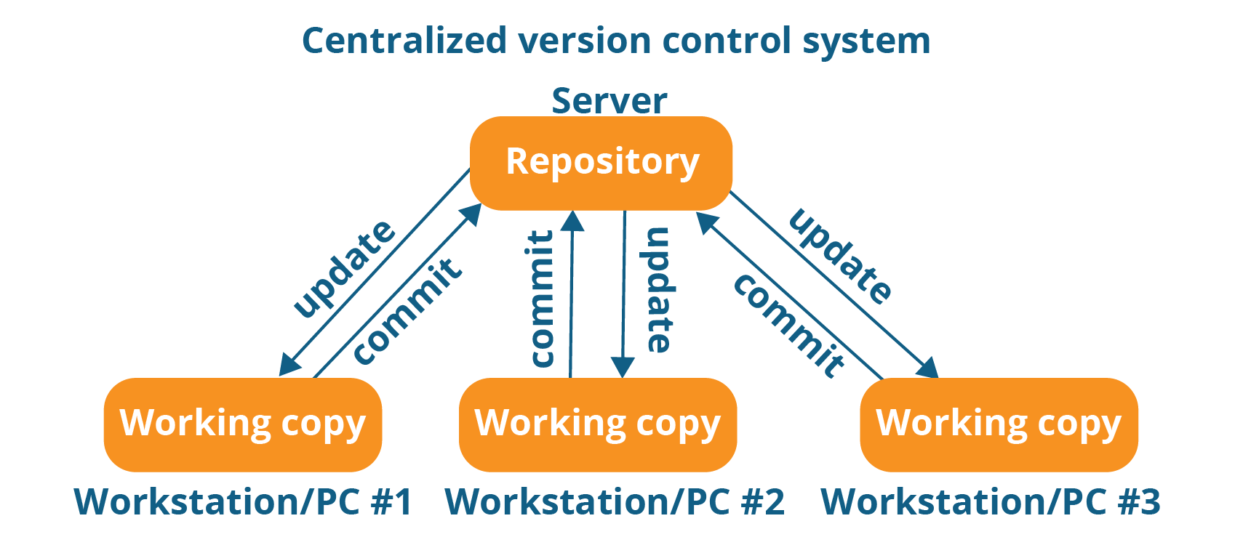
Collaborative Coding
Github enables “version control” for your software
Version control allows you to manage updates and changes to your code
You save a copy of your software in a “repo” on Github.
After you make changes on your local copy you have the option to save them in your repo

Slide 7
Benefit of Version Control
The Benefits of Version Control:
Ability to collaborate on software with other people
Always have a saved copy of your software
Ability to restore software in the event of a disaster
Keeps logs of code changes so you can identify bugs
Always have a back up of your code

Slide 8
Quick Activity!
Suggested Time: 3 min
Turn to your neighbor, and have one of you explain to the other:
The concept of version control.
Then the other should explain:
Two of the key advantages to using a version control system.

Slide 9

So… What’s this GitHub?
GitHub is a Web-Based hosting service to store code online.
It allows developers to pull (download) code or push (upload) code to the same repository (directory).
It also allows developers to view histories of code changes and to track issues.

Slide 10



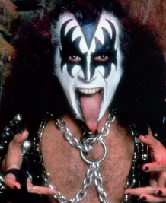

Pushing and Pulling to GitHub
1
2
3
4
GitHub Branch
Pull Code
Push Code
Pull Code
Pull Code
Push Code
Pull Code
Push Code

Slide 11
Rules for Group Collaboration with Github
Make sure that every team agrees upon the state of the code in the repository on github. The code in repository is also called the “MASTER BRANCH”
When looking to make changes to the “MASTER BRANCH” you make a copy of it aka “Cloning” on to your local computer
Never directly edit the “MASTER BRANCH”.
Create a copy of the “MASTER BRANCH” on your computer by creating your own branch.
Push your branch to github and a copy of your code will live parallel to the “MASTER BRANCH”
Then after the project administrator reviews your branch they will merge it with the “MASTER BRANCH”

Slide 12
Get Started with Git

Slide 13
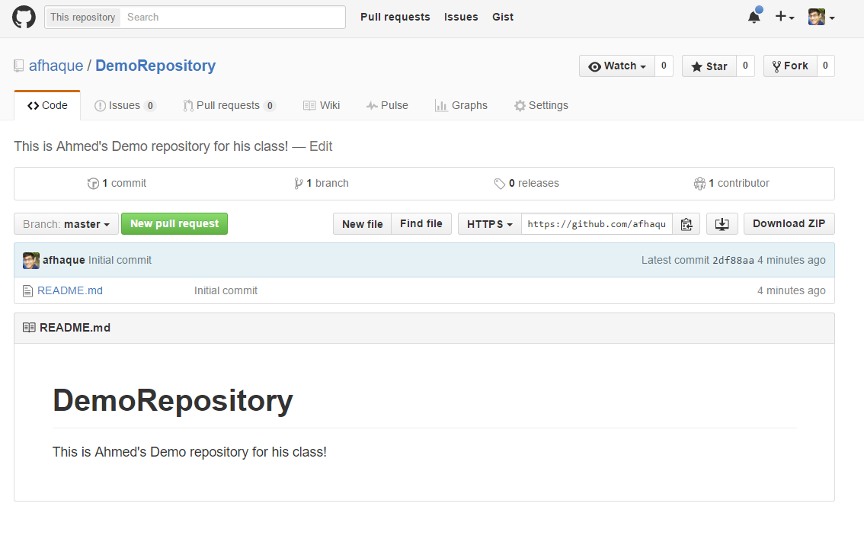
Instructor Git Demo!
Note: Walk Through how to make git repo. Any issues ask TAs to help

Slide 14
Basic Git Commands
At its most basic, these are the five git commands to get started:
git clone
git add
git commit
git push
git pull

Slide 15
Basic Git Commands
At its most basic, these are the five git commands to get started:
git clone – copies an entire repo (to begin).
git add – adds a file for inclusion in Git.
git commit – notes a change to the local repo.
git push – sends changes to hosting service.
git pull – downloads freshest version of repo.

Slide 16
> YOUR TURN!
Activity: Git Add, Commit, Push | Suggested Time: 20 min
Assignment:
Using GitHub and the Command Line:
Create a new public GitHub repository and name it whatever you like. Be sure to check the box for “initialize this repository with a README.”
Next, clone the repo to your local directory.
Then create an HTML file inside the local directory.
Add, Commit, and Push the code to GitHub.
Bonus:
Find a partner in class, and fork their repository to your own GitHub account. Clone this forked repository to your local directory.
Add, Commit, and Push the code back to your forked copy.
Finally, submit a pull request to send your changes to your partner’s repo.

Slide 17
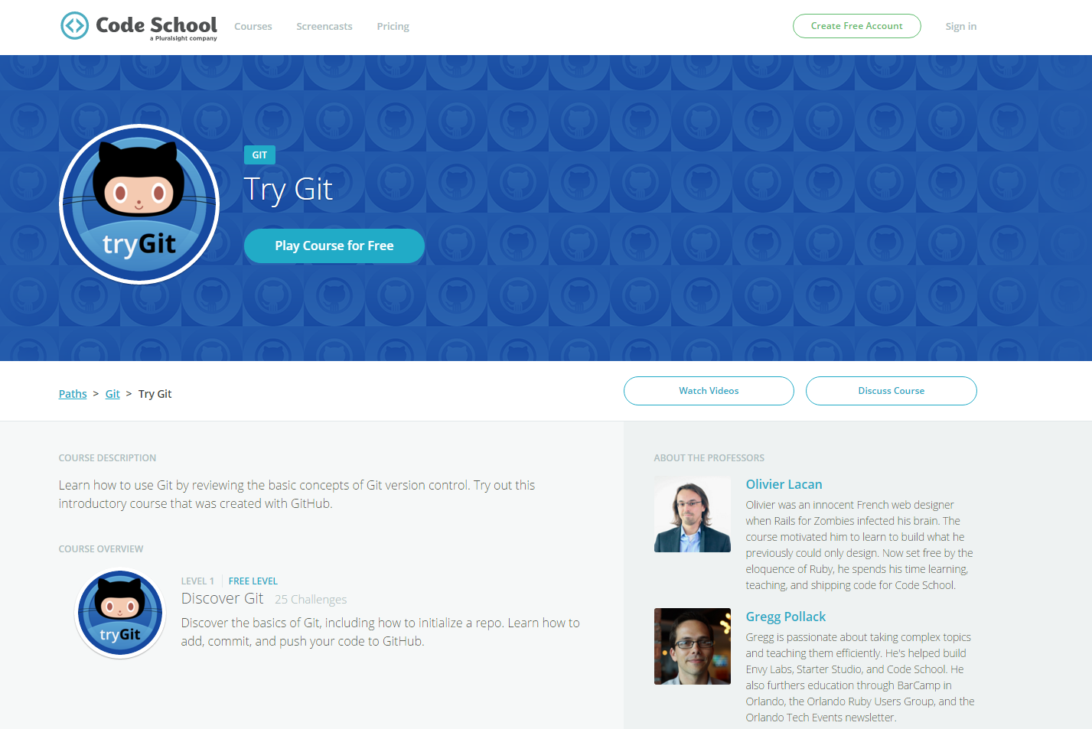
If You’re Still Lost… Here’s a (Free) Course
https://www.codeschool.com/courses/try-git

Slide 18
Hello, HTML

Slide 19

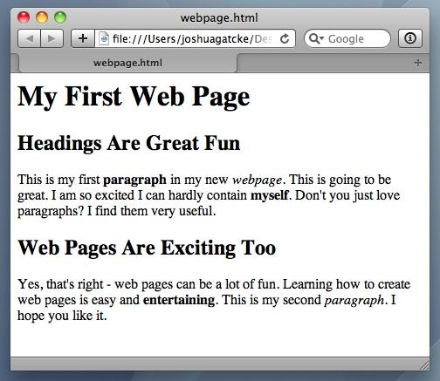
<title> Intro to HTML </title>
HTML (HyperText Markup Language) is the most basic building block of the Web. It describes and defines the content of a webpage. HTML is a fairly simple language made up of elements, which can be applied to pieces of text to give them different meaning in a document (is it a paragraph? is it a bulleted list? is it part of a table?), structure a document into logical sections (does it have a header?

Slide 20
Your Turn
5 minutes
Note: walk-through 03-my-first-html first
Assignment:
In a new HTML file, create the basic structure of an HTML document and include the following in it:
DOCTYPE declaration.
Head tag with a title tag.
H1 tag with a title of your choice.
Embed an image.
Create the following three links on your page:
One link that is target="_blank" so that it opens a new tab when clicked on.
Make the second link bold.
Make the third link a placeholder so it goes nowhere.
Bonus:
Create an ordered list of steps to make a sandwich.
Create an unordered list of 5 bands/musicians you like.
Create a table with 2 columns (animal class and animal name) and 4 rows of animals.
Use an alternate way of separating links without line breaks.
Add file to repo and push it to github

Slide 21
HTML Round 2

Slide 22
HTML Syntax (Basic)
Content
<h1>
This is Mah House
</h1>
Opening Tag
Closing Tag

Slide 23
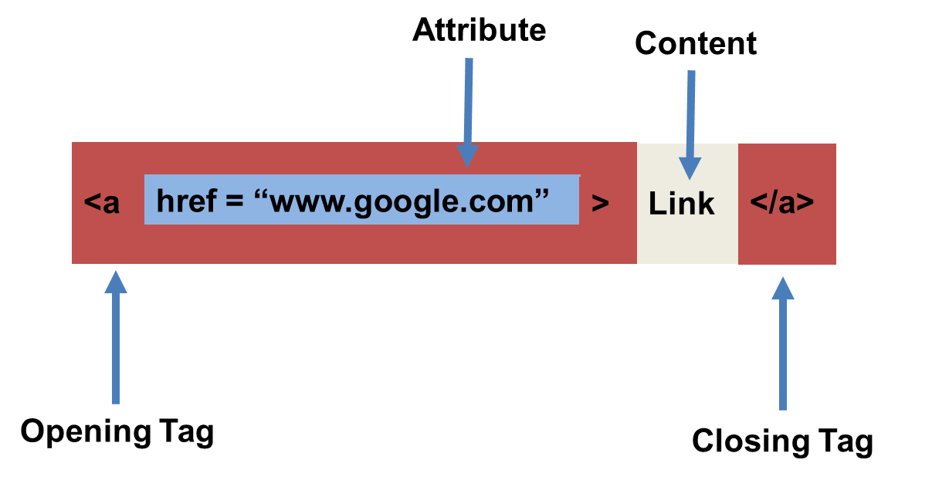
HTML Syntax (with Attribute)

Slide 24
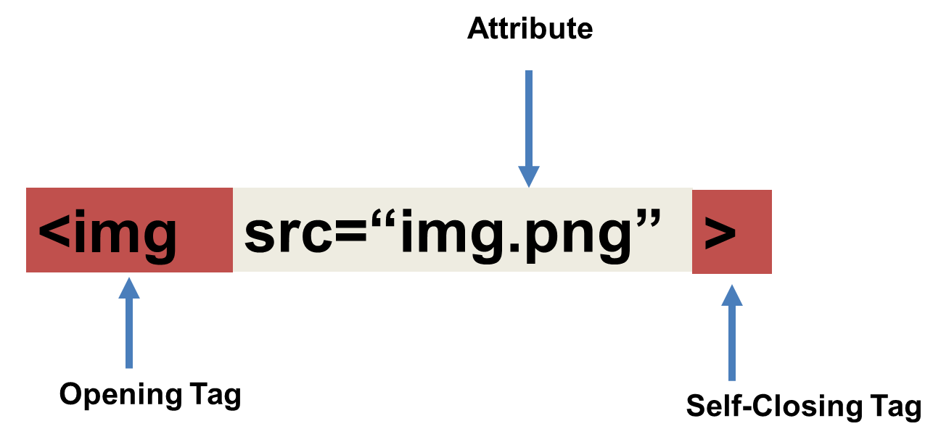
Tricky Tags (Self-Closing)

Slide 25
Important Common Tags
Headings:
<h1> </h1> - Heading 1 (Largest Heading)
<h2> </h2> - Heading 2 (Next Largest Heading)
<h3> </h3> - Heading 3
…
Containers:
<html> </html> - Wraps the entire page
<head> </head> - Wraps the header of the page
<body> </body> - Wraps the main content
<div> </div> - Logical Container ***
<p> </p> - Wraps individual Paragraphs
Others:
<strong> (bold), <em> (emphasis)
<img> (images), <a href> (links), <li> (list items) , <title> (title), <br> (line break), <table> (tables), <!-- --> (comments)

Slide 26
Less Common Tags
All HTML Tags are listed here: http://www.w3schools.com/tags/
Don’t try to memorize them! Simply refer back to documentation as needed.
Other tags:
<video> for Videos
<audio> for Audio files
<embed> for Embedded files
<code> for including computer code
<header> for headers
<nav> for navigation bars
<footer> for footers

Slide 27
HTML for Forms
Common UI (User Interface) Form Elements:
<form> - Creates a form section in HTML
<input> - Input boxes
<label> - Labels for boxes
<button> - Button
<textarea> - Large textbox

Slide 28
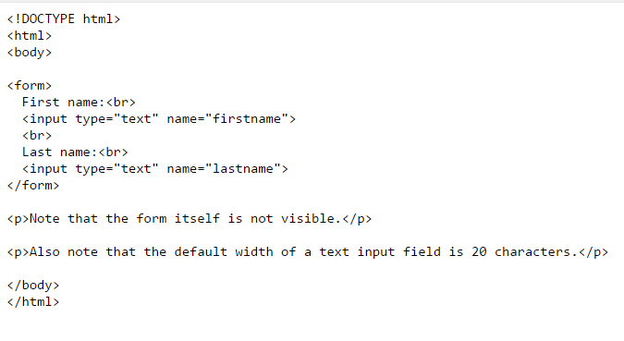
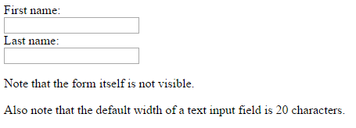
HTML for Forms

Slide 29
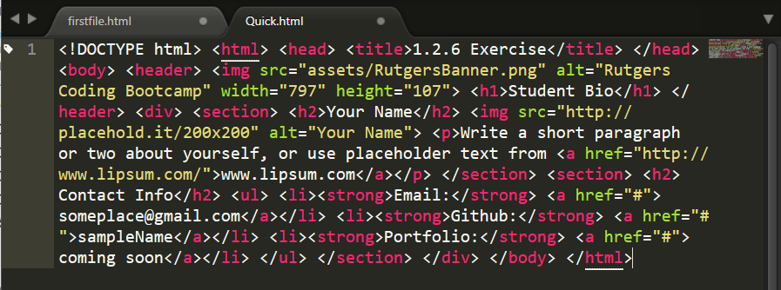
On Ugly HTML
Don’t do this… Use proper indentation and sectioning.
Readable code is easier to maintain.
Invest time to get better about this now. It will pay dividends!

Slide 30
> YOUR TURN!
Activity: 1-HTML_Git | Suggested Time: 20 min
Assignment
In this activity, you’ll create a student bio using HTML. You will then add, commit, and push your completed HTML to GitHub for the world to see.
Additional instructions, sent via Slack.

Slide 31
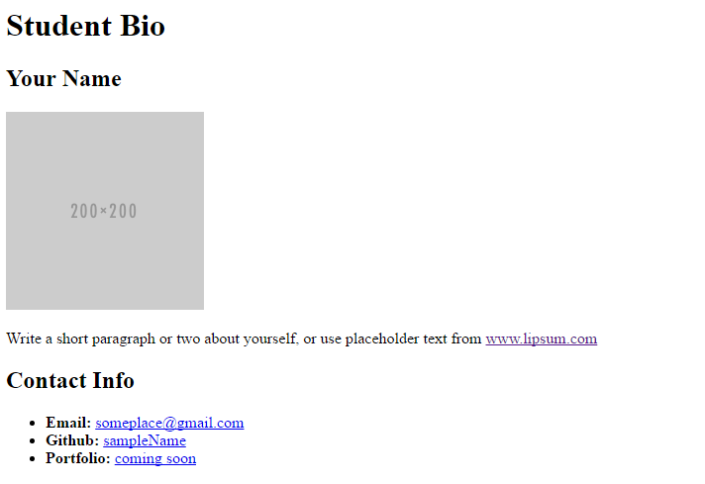
> YOUR TURN!

Slide 32
CSS Stylin’

Slide 33
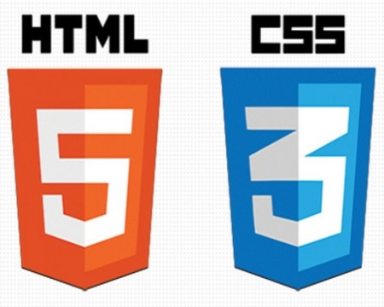

HTML / CSS Definitions (*yawn* unimportant)
HTML: Hypertext Markup Language – (Content)
CSS: Cascading Style Sheets – (Appearance)
HTML/CSS are the “languages of the web.” Together they define both the content and the aesthetics of a webpage – handling everything from the layouts, colors, fonts and content placement. (JavaScript is the third – handling logic, animation, etc.)

Slide 34


HTML / CSS Analogy
HTML Alone
Like writing papers in “Notepad.”
Can only write unformatted text.
HTML / CSS
Like writing papers in Microsoft Word.
Can format text, page settings, alignment, etc. based on “highlighting” and menu options.

Slide 35
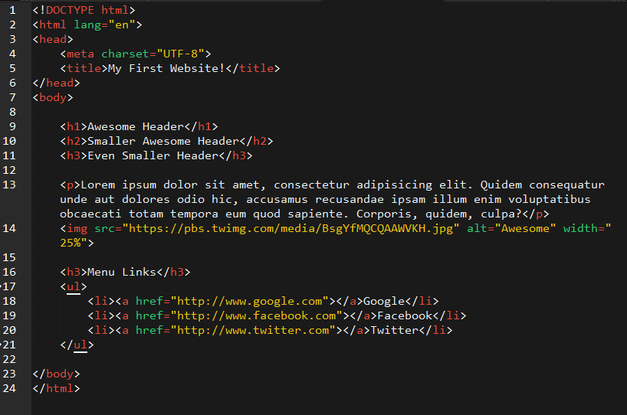
Basic HTML Page

Slide 36
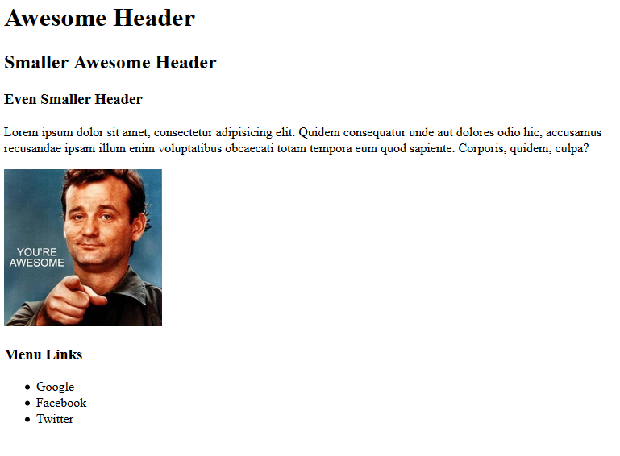
Basic HTML Page - Result

Slide 37
Basic HTML Page - Result
Hella Boring…

Slide 38
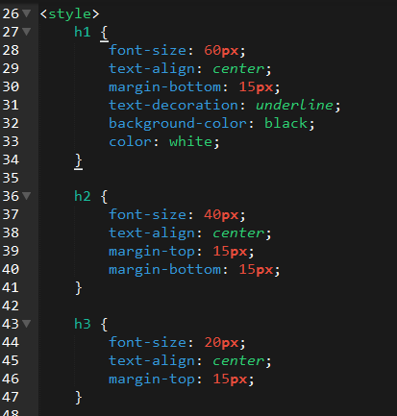
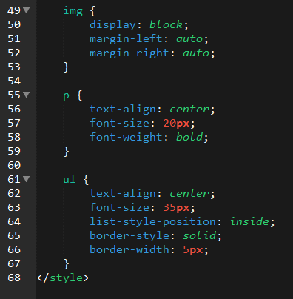
Enter CSS

Slide 39
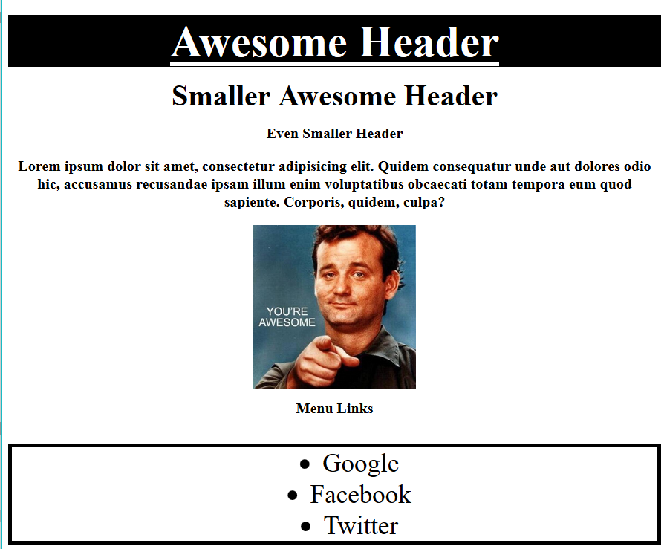
Enter CSS - Result

Slide 40
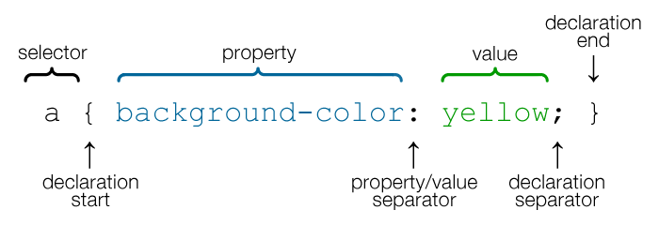
CSS Syntax
CSS works by hooking onto selectors added into HTML using classes and identifiers.
Once hooked, we apply styles to those HTML elements using CSS.

Slide 41
CSS Example
In the below example the “Header” would be turned blue and MUCH larger because of the CSS.
We can incorporate an element’s class or ID to apply a CSS style to a particular part of the document.
Just remember to include the necessary symbol before the CSS: “.” for class, “#” for ID.
Example (HTML):
<p class=“bigBlue”>Header</p>
Example (CSS):
.bigBlue
{
font-size: 100px;
color: blue;
}

Slide 42
Key CSS Attributes
Font / Color:
color: Sets color of text.
font-size: Sets size of the font.
font-style: Sets italics.
font-weight: Sets bold.
Alignment / Spacing:
padding (top/right/bottom/left): Adds space between element and its own border.
margin (top/right/bottom/left): Adds space between element and surrounding elements.
float: Forces elements to the sides, centers, or tops.
Background:
background-color: sets background color.
background-image: sets background image.

Slide 43
Powerful Duo
Believe it or not, HTML / CSS is all you need
to develop a vivid, full-blown website.

Slide 44
INSTRUCTOR DEMO
Instructor: Demo
(quickexample_internalcss.html | 2-BasicCSS)

Slide 45
> YOUR TURN!
Activity: 3-HTML_CSS_Layout | Suggested Time: 20 min
Assignment
In this activity, you’ll upgrade your previous HTML bio-page using CSS style rules. Once you’re done, commit and push up your changes to GitHub.
We’ll send you additional instructions via Slack.

Slide 46
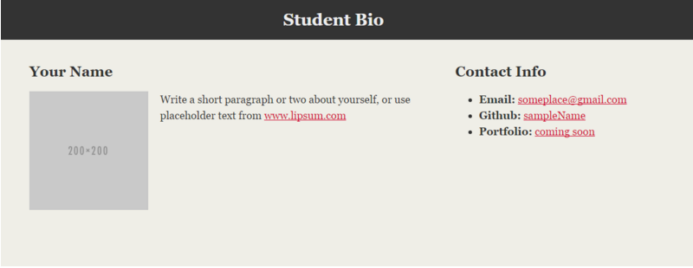
> YOUR TURN!

Slide 47
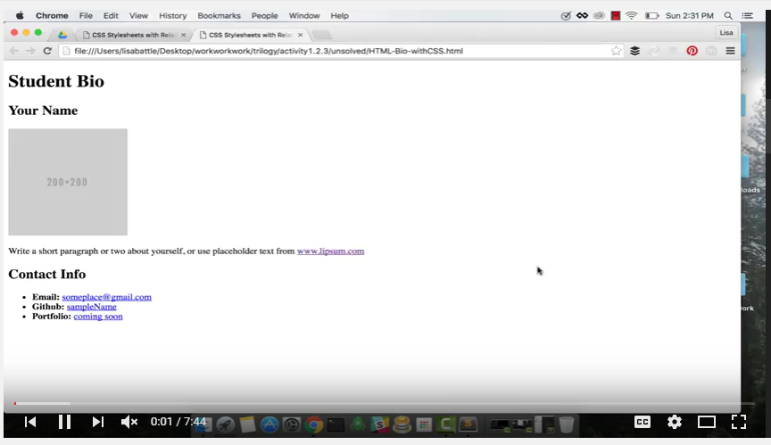
Video Walkthrough!!
https://www.youtube.com/watch?v=kMBinXTCrXI&list=PLgJ8UgkiorCnMLsUevoQRxH8t9bt7ne14&index=2

Slide 48

Still a Bit Confused?
Remember! We’ve got video guides for key activities like that last one.
If you feel like you are EVER falling behind, use those online walkthroughs to help catch back up. They are made to be easy to understand.
Still having trouble? Shoot your instructor or one of your TAs a message!
We are here to help you out in whatever way we can!

Slide 49
Recap + Questions

